Slide 1


A Comprehensive Guide to Dart Programming:
Object-Oriented Principles, Functional Concepts
Notes:
This presentation will provide a comprehensive overview of Dart programming, covering object-oriented principles, functional concepts, error management, code optimization, and package utilization.

Slide 2

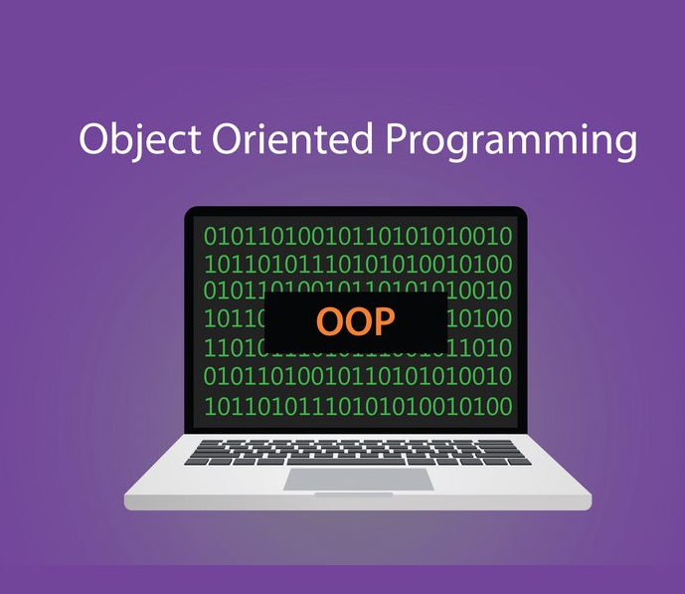
Object-Oriented Programming in Dart
Dart is an object-oriented programming language.
The main goal of oops concepts in dart is to reduce programming complexity & can execute many tasks at once.
Object-Oriented Programming (OOP) in Dart offers several benefits, making it easier to build scalable, maintainable, and reusable software.
Notes:
Object-oriented programming (OOP) is a fundamental paradigm in Dart. Classes act as templates for creating objects, encapsulating data and functionality. Inheritance allows code reuse and creates relationships between classes. Polymorphism enables flexible method calls, making code more adaptable. Understanding class members like properties, methods, and constructors is essential for building well-structured and reusable Dart applications.

Slide 3
Oops
Defining classes and creating objects
Understanding class members: properties, methods, and constructors
The Three Pillars of OOPs:
Inheritance
Ploymorphism
Abstraction
Encapsulation
Notes:
Object-oriented programming (OOP) is a fundamental paradigm in Dart. Classes act as templates for creating objects, encapsulating data and functionality. Inheritance allows code reuse and creates relationships between classes. Polymorphism enables flexible method calls, making code more adaptable. Understanding class members like properties, methods, and constructors is essential for building well-structured and reusable Dart applications.

Slide 4
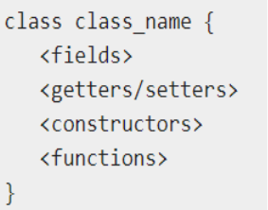
Class
A class in terms of Oops is the blueprint of objects.But compared to other languages, class have less importance in dart.Class can be used for declaring, allocating space, storing, sharing objects.
The class keyword is followed by the class name. The rules for identifiers must be considered while naming a class.
Inside Class there are 4 types of attributes:
fields
getters/setters
Constructors
functions
Notes:
A class in terms of Oops is the blueprint of objects.
Fields : a field is any variable declared inside a class. A field represent data pertaining to objects.
Functions : functions refers to the action an object can take. It can also be called as methods.
Constructors : responsible for allocating memory to new objects.
Setters/Getters : Allows the program to initialize and retrieve the values of the fields of a class. A default getter/ setter is associated with every class. However, the default ones can be overridden by explicitly defining a setter/ getter.

Slide 5
Inside Class there are 4 types of attributes:
fields : Fields are variables that store data for objects.
getters/setters :getters are methods that retrieve the value of a property, while setters are methods that update the value of a property, helping to control access to class fields.
Constructors :Constructors are special functions that create instances of classes.
functions :Functions refers to the action an object can take. It can also be called as methods.
class Student{
// field
String name =”Name”;
//function
void detail(){
print(name);
}
}
Notes:
A class in terms of Oops is the blueprint of objects.
Fields : a field is any variable declared inside a class. A field represent data pertaining to objects.
Functions : functions refers to the action an object can take. It can also be called as methods.
Constructors : responsible for allocating memory to new objects.
Setters/Getters : Allows the program to initialize and retrieve the values of the fields of a class. A default getter/ setter is associated with every class. However, the default ones can be overridden by explicitly defining a setter/ getter.

Slide 6
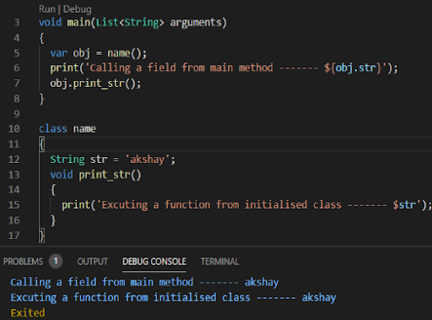
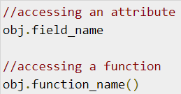
Object
Objects are instances of classes and have properties (attributes) and methods (actions).
Eg:
Here we created a class with one field(str) and one function (print_str)
On main method we declared a variable(obj) with value equal to that class name
And we accessed that class field and function through that variable.
Notes:
The object itself is what holds any specific data and logic.

Slide 7
Functions
Functions are the building blocks of readable, maintainable, and reusable code.
Function
Return_typefuc_name(parameter_list){
//statement(s)
return value;
}
Notes:
Defining a function - a function definition requires when and how a specific task would be done.
Calling a function - A function must be called in order to execute it.
Returning functions - functions may also return values back along with the control, to the caller.
Parameterised functions - Parameters are a mechanism to pass values between the function.we can pass more than one parameter or what our object we want. But to receive, we must define data type.

Slide 8
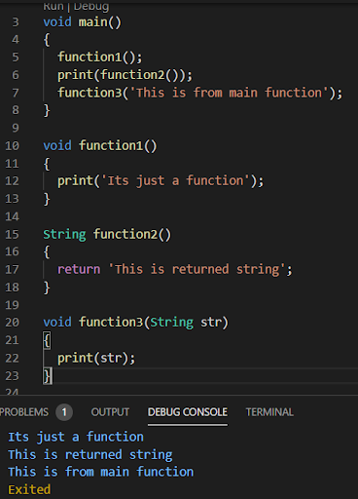
Defining a function - a function definition requires when and how a specific task would be done.
Calling a function - A function must be called in order to execute it.
Returning functions - functions may also return values back along with the control, to the caller.
Parameterised functions - Parameters are a mechanism to pass values between the function.we can pass more than one parameter or what our object we want. But to receive, we must define data type.
Notes:
Defining a function - a function definition requires when and how a specific task would be done.
Calling a function - A function must be called in order to execute it.
Returning functions - functions may also return values back along with the control, to the caller.
Parameterised functions - Parameters are a mechanism to pass values between the function.we can pass more than one parameter or what our object we want. But to receive, we must define data type.

Slide 9
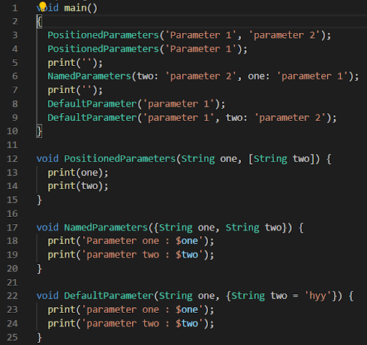
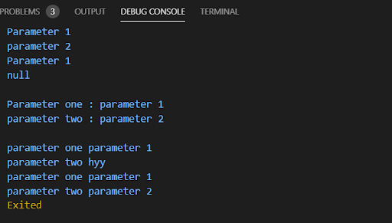
Parameter function Types
Optional positional parameter - To specify optional positional parameters, use square [] brackets
Optional named parameter - Unlike positional parameters, the parameter's name must be specified while the value is being passed. Curly brace {} can be used to specify optional named parameters.
Optional parameter with default value - Function parameters can also be assigned values by default. However, such parameters can also be explicitly passed values.
Notes:
Dart parameters can be categorized broadly into two types: positional parameters and named parameters. Positional parameters are the traditional way of passing arguments to a function. They are defined in the function declaration and passed into the function in the same order when calling the function.

Slide 10
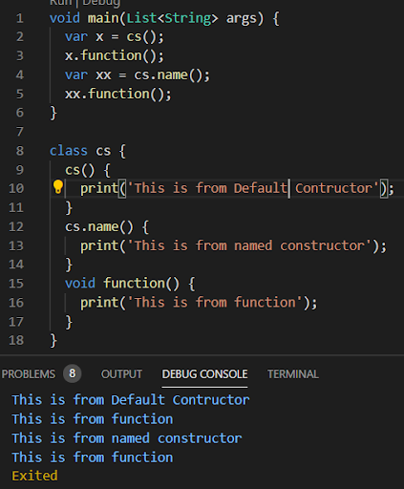
Constructors
Constructors are function which we will create with the name of class itself and,
Which will execute automatically when the class is called.
There are named constructors in dart, which will allow us to create and call by the default name we create. This constructor will only execute only if its called by that name.
Notes:
Constructors are function which we will create with the name of class itself and which will execute automatically when the class is called.

Slide 11
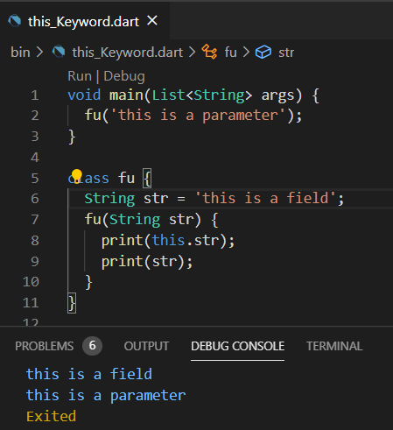
this keyword
The keyword this refers to the current instance of the class.
In the example, we have two string values with name str,
One already defined in the class
Second is received from the parameter
By only using this keyword we printed the value from the class.
Notes:
The keyword this refers to the current instance of the class.

Slide 12
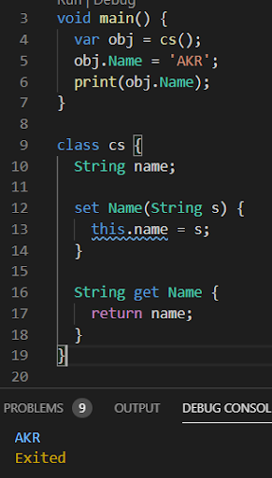
Setters/Getters
Getters or accessors are defined using get keyword.
Setters or mutators are defined using set keyword.
(The setter must be executed first, otherwise getters will get a null value)
Notes:
Getters and setters are used to access and modify the private fields of a class, respectively. They provide controlled access to the fields.

Slide 13
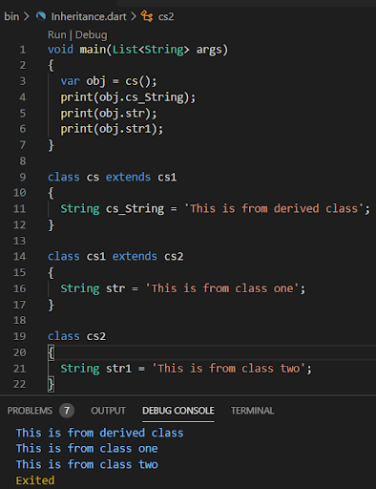
Class Inheritance
Class Inheritance is used to access a class(parent class) by another class (child class).
The inherited class objects by making the object of derived class.
Three are commonly used Inheritance:
Single Inheritance
Multi-level Inheritance
Hierarchial Inheritance
Notes:
Inheritance allows a class to be defined that has a certain set of characteristics (fields, methods) and then other classes to be created that are derived from that class.

Slide 14
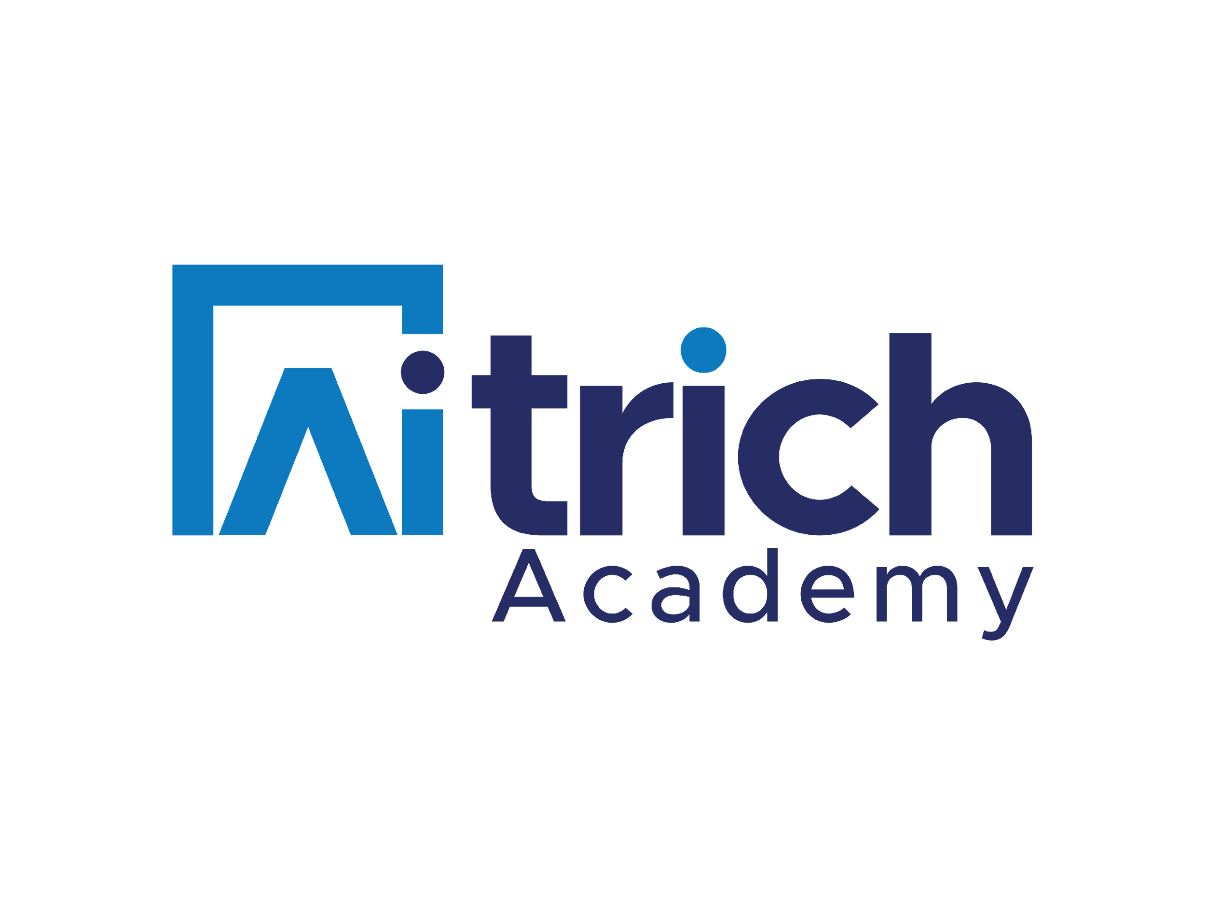
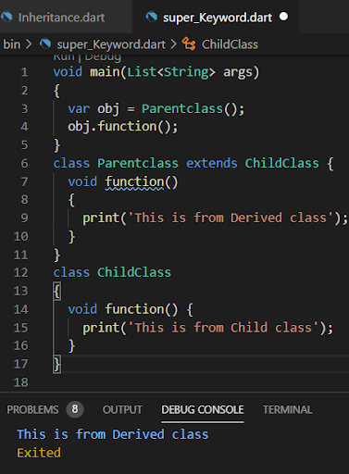
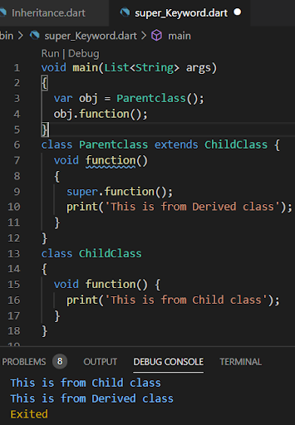
Super keyword
super.myFunction() calls the parent's version of the function from within the child class.
This allows for both shared functionality (in the parent) and custom implementation (in the child).
The order of execution is determined by the placement of super.myFunction() within the child's function.

Slide 15
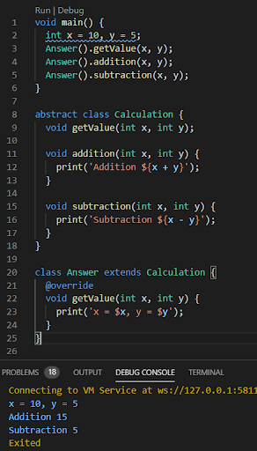
Abstract class and method
Abstract Method
To make a method abstract, use semicolon (;)Instead of method body
Abstract method can only exit with Abstract class
You need to override Abstract methods in subclass
Abstract Class
Use abstract keyword to declare Abstract Class.
Abstract class can have Abstract Methods, Normal Methods and Instance Variables as well
The Abstract Class cannot be instantiated, you cannot create objects. But can be inherited
Notes:
Abstraction means dealing with the level of detail that is most appropriate to a task, and it often involves creating abstract classes that can't be instantiated on their own. These abstract classes are meant to be subclassed by other classes that provide concrete implementations of the abstract methods. Dart provides the abstract keyword to define abstract classes and methods.

Slide 16
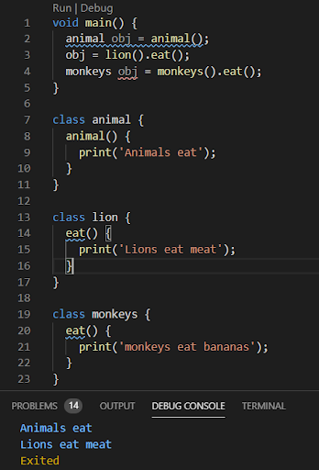
Polymorphism
Polymorphism is the ability of an object to take many forms.
There are two types of polymorphism
Compile time
Run time
The example here shows the ability of an object name obj to take many forms.
Notes:
Polymorphism in Dart refers to the ability of objects of different classes to be treated as objects of a common superclass.

Slide 17
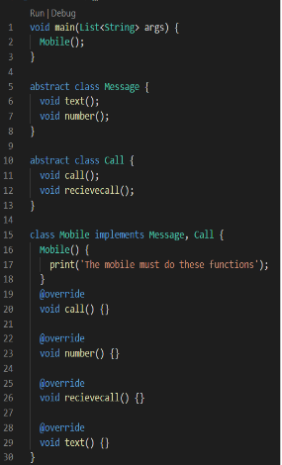
Interface
Dart does not have special syntax to declare INTERFACE
An INTERFACE in dart is Normal Class
An INTERFACE is used when you need concrete implementation of all its function within the subclass, it is mandatory to override all methods in implementing class.
You can implement multiple classes but you cannot extend multiple classes during inheritance.
(Interface importance comes in flutter when we go to cross platforms)

Slide 18

Effective Dart: Writing Clean and Maintainable Code
A
Write clean, readable, and maintainable Dart code by following best practices.
B
Employing effective naming conventions, code formatting, and documentation
C
Utilizing code review processes to refine code quality and consistency
Notes:
Writing clean and maintainable code is important for any programmer. It makes your code easier to understand, debug, and modify. There are a number of best practices for writing clean Dart code, such as using consistent naming conventions, proper commenting, and avoiding unnecessary complexity.

Slide 19


Conclusion
Recap of the key takeaways from the presentation:
Class & Object
Constructors
Parameter function
The Three Pillars of OOPs:
Inheritance
Ploymorphism
Abstraction
Notes:
This presentation has provided a comprehensive overview of Dart programming, covering various essential concepts and practices. Remember that Dart is a continuously evolving language with new features and improvements being introduced regularly. Stay updated with the latest developments and continue to explore its capabilities to become a proficient Dart developer.

